Slide 1
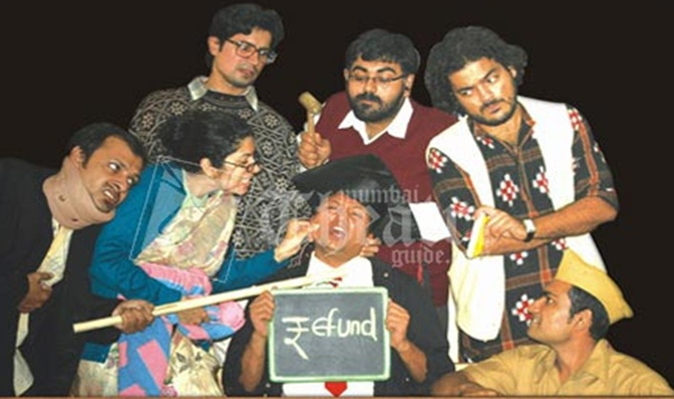
Department Of Humanities and Social Sciences ,JIIT,NOIDA

Slide 2
Key points to be Covered:
About the writer
About the Play
Analysis
Important Illustrations
Important Annotations
Objective & subjective questions
Resources for further Study:
http://egyankosh.ac.in/bitstream/123456789/27478/1/Unit-4.pdf

Slide 3
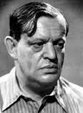
REFUND
Fritz Karinthy (1887-1938)
About the author Fritz Karinthy (1887-1938) was a Hungarian writer. He excelled as a novelist, short story writer, poet, essayist and playwright. Deeply interested in natural sciences, he studied to be a teacher, but became a journalist and joined the literary periodical Nyugat. Strongly philosophical and humanistic in his outlook, he raised his powerful voice against the barbarism and horrors of World War I.

Slide 4
The play refund is full of humour which deals with an extraordinarily ludicrous situation. The main character in the play is Wasserkopf. He is forty years old. He could not get any employment and wherever he went the people told him that he is fit for nothing and he hasn’t learnt anything.One day he met a Lederer and asked him about his business. When the Lederer told him about foreign exchange and Hungarian money, he was not able to understand anything and started asking questions about foreign exchange to the Lederer. For which the Lederer said when you don’t know the silly thing what have you studied, you better go to your school and get your tuition fees back.
About the play:

Slide 5
Wasserkopf who was jobless and didn’t have any financial support, this idea sounded something beneficial to him and so he went to the school where he studied once.
When he asks for the refund of his tuition fees, the principal is shocked because after eighteen years he has come to the school thinking that he has learnt nothing worthwhile and so he can get his tuition fees back. The principal is perplexed and he calls for an urgent meeting with all other staff members. They decided to keep a re-examination for Wasserkopf and agreed that whatever answers he gives whether it is right or wrong they will prove him right. One by one each teacher questions him and justified his wrong answer to be correct one and they mark him excellent.

Slide 6
Though Wasserkopf gives wrong answers and use abusive words to each teacher, they don’t show their anger because they have to prove him as an excellent student to chuck him out.
At least the mathematics teacher asks him a difficult question and an easy question. For the easy question he gives wrong answer and the master gets angry and says that he has failed on his examination so he should be given his tuition fees back. The teacher says that we have decided to give you your tuition fees back and now can you tell as the exact amount which we have to give you. Wasserkopf without knowing that he is going to fall into their trap gives them the list of exact amount.

Slide 7
So the mathematics teacher says that was my difficult question to give the exact amount of your tuition fees for which you gave the right answer.
Now he is proved excellent in the entire subject and they throw him out without allowing him to say anything further. The play is full of humour and full of ludicrous situation. It also shows the ability of the teachers to manage the situation and how they tackle Wasserkopf without spoiling the reputation of their school.

Slide 8
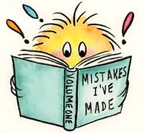
Some Illustrations from The Refund a one act play by Fritz Karinthy: The Refund comprises only a few characters i.e. the principal, the mathematics, physics, history and geography teachers and the protagonist, Wasserkopf .In order to communicate human values in this one act play Wasserkopf mistakes act as a learning ground.
Mistake 1: “The Principal- He’s waiting outside. He wants to be re-examined .He says he learned nothing. He says a re-examination will prove it.” Wasserkopf has a negative value i.e. determination but in doing wrong things.He is ready to do anything just to prove that his school has taught him nothing and his knowledge is negligible.

Slide 9
Mistake 2: “Wasserkopf: Who the hell are you? Sit down, you loafers!” The protagonist’s address to his teachers shows to the readers that how important the values of respect and accuracy are. No doubts viewers especially students will laugh on such utterance but ultimately as the play advances further, this behaviour is mere mockery over the pupils who are always ready to blame others and the system. The mistake committed thus is linked up with the chain of events which finally leads to a moral teaching.

Slide 10
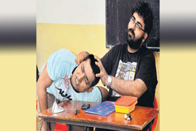
Mistake 3: “Wasserkopf: You’d better brush up your wits if you think you’re going to put one over on me.” Here the protagonist considers himself to be very wise. But in reality it is his mistake .True wisdom is shown in the form of the teachers. They are insulted at the hands of this pupil as he addresses them as ‘old stick-in-the-mud, cannibal. Hypocrite, nitwit, ass etc but they show patience and self control in teaching him a lesson.

Slide 11
Mistake 4: Wasserkopf: How long did the thirty years war last? Was that the question? The History Teacher: Yes, yes Wasserkopf: [grinning] I know exactly seven meters…… The History Teacher: Seven meters? Right ! Your answer is excellent …!” The accuracy of teachers is shown in accepting all the wrong answers as the correct ones. It’s just to teach this ex-pupil a lesson that if can lie and tell the wrong answers and thus outsmart them, and then the masters also have brain.

Slide 12
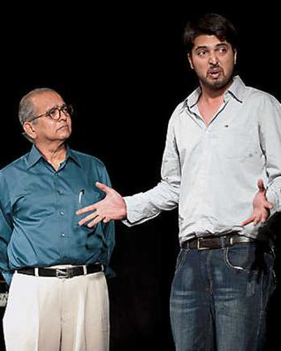
Mistake 5: “Wasserkopf- I was never serious in my life. Treat me wrong here and I’ll go straight to the ministry of education and complain about you! You took my money and you taught me nothing. Now I’m no good for anything, and I can’t do the things I should have learned at school Education .These words will straight away leave an impact on the minds of the readers that it is very easy to blame others .Wasserkopf never worked hard and he is fired from his job because of the same reason i.e. his inability to work hard.

Slide 13
Mistake 6: “Wasserkopf- Grand total: 6,450 crowns 50 hellers. Knock off The heller and call it crowns” Well in the end of the play it is ultimately proved that no doubts this ex-pupil tried to prove that his school taught him nothing, but it’s only his education which made him capable enough to calculate the correct sum in a systematic way. Therefore Wasserkopf had to suffer due to his lies and corrupt values.

Slide 14
Analysis:“The Refund” by Fritz Karinthy in which the protagonist is an object of wrong doings and he commits all sorts of mistakes and finally has to give up in the hands of the principal and the professors. His mistakes act like a learning ground for the readers and even the role players. It’s just like if one will do or act like this, one will surely suffer. For the beginner it gives a logical sequence which ensures that each point is considered before too many assumptions are made.

Slide 15
Important Annotations
1) Because I didn’t get my money’s worth, that’s why!
Examples:
Introduction: This line is taken from the play ‘Refund’ by Fritz Karinthy.
Context: The play is a satire on the present day education system.
Explanation: Wasserkopf, a good-for-nothing fellow, goes back to the school in which he had studied. He meets the Principal and insists that he is entitled to a refund of the entire fees paid by him as a student. The Principal is taken aback and asks the reason for this strange demand. Wasserkopf replies that he had not received a proper education. He had learnt nothing.
Notes:
https://www.google.com/imgres?imgurl=https%3A%2F%2Fimgv2-2-f.scribdassets.com%2Fimg%2Fdocument%2F406686248%2F298x396%2F3f7990fee7%2F1555567467%3Fv%3D1&imgrefurl=https%3A%2F%2Fwww.scribd.com%2Fdocument%2F406686248%2F6-Refund&tbnid=KBsy8ZLREZKYqM&vet=10CAkQMyhoahcKEwioofe7q7vrAhUAAAAAHQAAAAAQAg..i&docid=fPOVcIOt-5-QsM&w=298&h=396&q=refund%20play%20by%20fritz%20karinthy&ved=0CAkQMyhoahcKEwioofe7q7vrAhUAAAAAHQAAAAAQAg

Slide 16
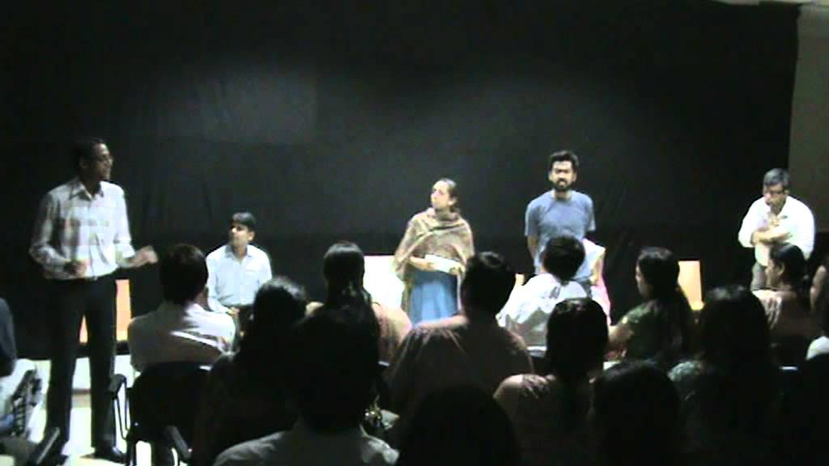
Comment: He is, therefore, justified in asking for a refund. He adds that a re-examination would prove that his claim is valid
2)We are dealing with a sly, crafty individual, who will try to get the better of us -and his money back-by hook or by crook, we must checkmate him.
3) Seven meters! I know it lasted that long.
Notes:
https://www.google.com/imgres?imgurl=https%3A%2F%2Fi.ytimg.com%2Fvi%2F9gXdhy3WXYc%2Fmaxresdefault.jpg&imgrefurl=https%3A%2F%2Fwww.youtube.com%2Fwatch%3Fv%3D9gXdhy3WXYc&tbnid=_wnJIt_EDUvlpM&vet=10CIEBEDMo7AJqFwoTCKih97uru-sCFQAAAAAdAAAAABAT..i&docid=J2sFGFuyJa9dbM&w=1024&h=576&q=refund%20play%20by%20fritz%20karinthy&ved=0CIEBEDMo7AJqFwoTCKih97uru-sCFQAAAAAdAAAAABAT

Slide 17
Learnings & Relevance
Transmitting human values
Social dimensions of education
Learning through mistakes
Education has the power to change a life.
Education is the knowledge that enables us to survive in this strange world.

Slide 18
Let’s revise
Q1 Wasserkopf came to school……….
a)To get certicate b)to draw his salary c)to get back the tution fees d) to file an FIR.
Q2 “I didn’t learn anything and want my back…..”
a) Wasserkopf b) servant c)Principal d) Maths Teacher
Q3 Wasserkopf intends…..
a)To pass the exam b)to fail the exam c) to sit for the exam d) to avoid the exam
Q4 Wasserkopf was student……..
a)18 yrs ago b)24 yrs ago c) 14 yrs ago d) 20 yrs ago
Q5 Refund is ……
a)One act- play b) two act- play c) Three act-play

Slide 19
Self-check questions
What prompted Wasserkopf to go to his school seeking
a refund of his tuition fee?
“Whatever his answer, we agree beforehand that they
are correct.” Who is the speaker?
Who is he speaking to? Why?

Slide 20
References and Images sources
http://sujarithasaravanan.blogspot.com/2019/10/refund-fritz-karinthy-summary.html#:~:text=
https://www.google.com/search?q=refund+play+by+fritz+karinthy&rlz=1C1GGRV_enIN764IN764&sxsrf=ALeKk019Y6ms075H4fxpM04sJYTD4rEYqA:1598528987742&tbm=isch&source=iu&ictx=1&fir=vk8NMBCtx_RlJM%252CXnVqzlZwJNBHGM%252C_&vet=1&usg=AI4_-kQwRZ_qYEPQ6txqWSSz4ogB4k9GrA&sa=X&ved=2ahUKEwiesujDqLvrAhXjwjgGHfAXB7kQ9QF6BAgHEBw#imgrc=vk8NMBCtx_RlJM
https://www.google.com/imgres?imgurl=http%3A%2F%2F3.bp.blogspot.com%2F-Z84eSy7yDII%2FUhD2_XbgDuI%2FAAAAAAAABYQ%2F6lh-DU0wpLc%2Fs1600%2Fimages%2B(1).jpg&imgrefurl=http%3A%2F%2Foscareducation.blogspot.com%2F2013%2F08%2Frefund-one-act-play-summary-02.html&tbnid=gzdUG6LvSKw8bM&vet=12ahUKEwjm8eCA2sDrAhUd5jgGHVHSB9cQMygJegUIARCrAQ..i&docid=fUH-PDDjxs50UM&w=188&h=268&q=Images%20of%20fritz%20karinthy&ved=2ahUKEwjm8eCA2sDrAhUd5jgGHVHSB9cQMygJegUIARCrAQ
https://www.google.com/imgres?imgurl=https%3A%2F%2Fimages.newindianexpress.com%2Fuploads%2Fuser%2Fimagelibrary%2F2012%2F9%2F26%2F0%2Fw600X300%2FA-refund-from-school.png&imgrefurl=https%3A%2F%2Fwww.newindianexpress.com%2Fcities%2Fhyderabad%2F2012%2Fsep%2F26%2Fa-refund-from-school-409707.html&tbnid=FRETW_ZtdrKHlM&vet=12ahUKEwjrzKqGq7vrAhW54TgGHc6NACEQMygdegUIARDRAQ..i&docid=s0nVbMkQ1gB4NM&w=600&h=300&itg=1&q=refund%20play%20by%20fritz%20karinthy&ved=2ahUKEwjrzKqGq7vrAhW54TgGHc6NACEQMygdegUIARDRAQ
https://www.google.com/imgres?imgurl=https%3A%2F%2Fi.ytimg.com%2Fvi%2F9gXdhy3WXYc%2Fmaxresdefault.jpg&imgrefurl=https%3A%2F%2Fwww.youtube.com%2Fwatch%3Fv%3D9gXdhy3WXYc&tbnid=_wnJIt_EDUvlpM&vet=10CIEBEDMo7AJqFwoTCKih97uru-sCFQAAAAAdAAAAABAT..i&docid=J2sFGFuyJa9dbM&w=1024&h=576&q=refund%20play%20by%20fritz%20karinthy&ved=0CIEBEDMo7AJqFwoTCKih97uru-sCFQAAAAAdAAAAABAT

